Slide 1




Apache Kafka
Session I : INTRODUCTION

Slide 2
Quiz
Which was the most used dating site/app in 2014?
Which is the most used dating site/app in 2024?

Slide 3
Significance of Data
A famous Quote – “Without data, you are just another person with an opinion.”

Slide 4
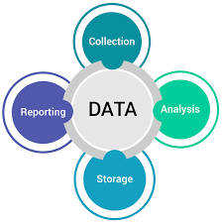
Data

Slide 5
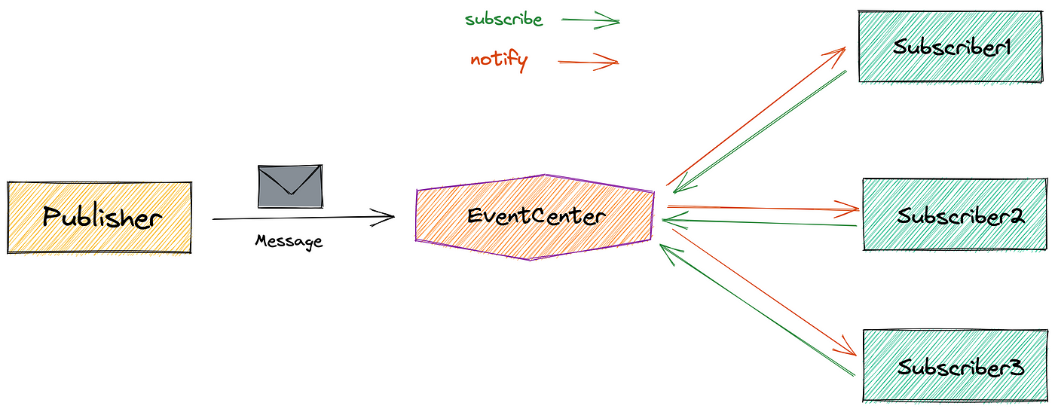
Publish/Subscribe Messaging Pattern

Slide 6

How Pub/Sub Messaging starts…

Slide 7
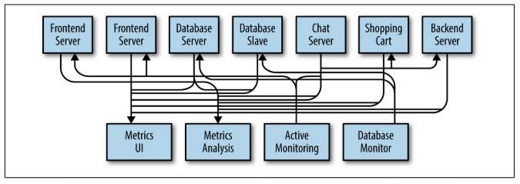
Soon after… it becomes like this…

Slide 8
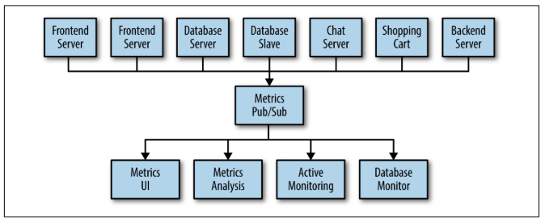
Building a Publish-Subscribe Messaging System

Slide 9
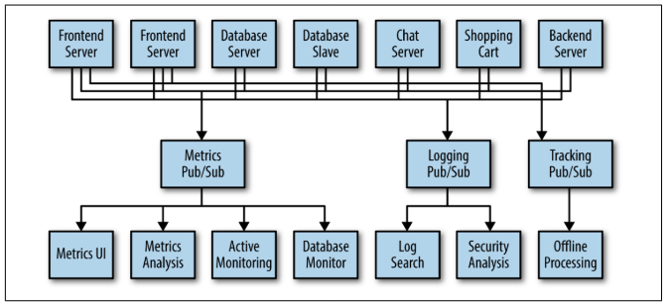
Individual Queue Systems

Slide 10
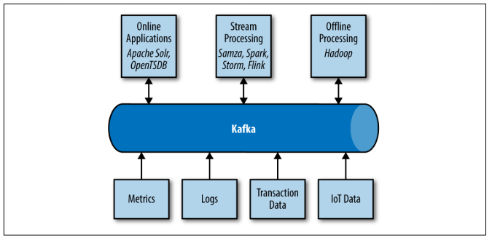
Enter to the World of Kafka…

Slide 11
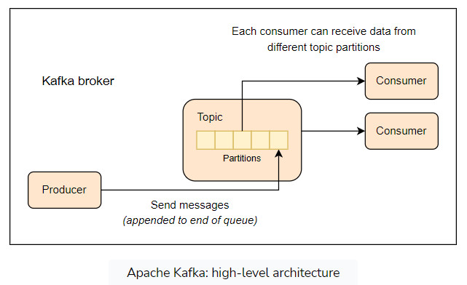
Apache Kafka – Key Components

Slide 12
Kafka Components
Messages & Message Schemas
Topics & Partitions
Producers
Consumers
Brokers & Clusters

Slide 13
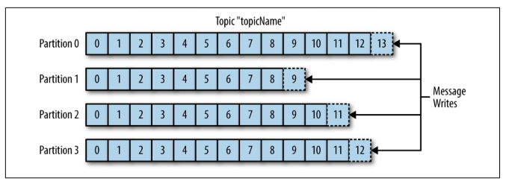
Topics & Partitions in Kafka

Slide 14
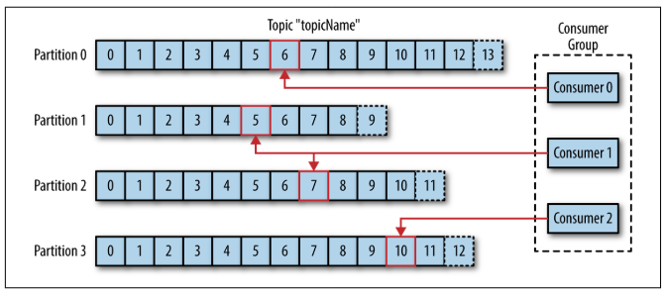
Consumers in Kafka…

Slide 15
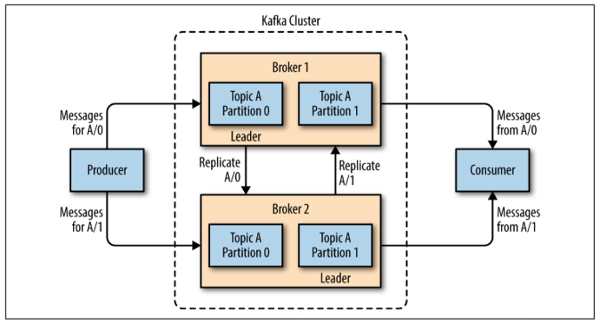
Brokers & Clusters in Kafka…

Slide 16
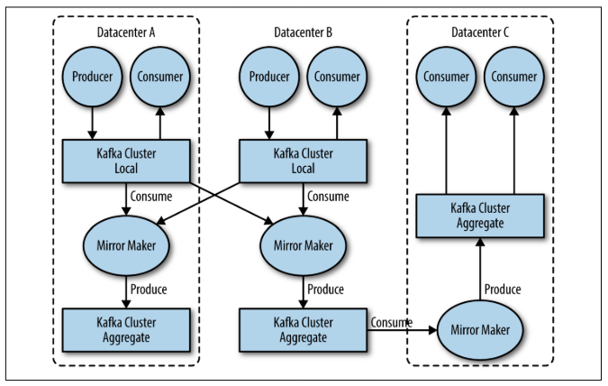
MirrorMaker…

Slide 17
WHY Kafka?
Multiple Producers
Multiple Consumers
Disk-Based Retention
Scalable
High Performance

Slide 18
Kafka : Use Cases
Activity tracking
Messaging
Metrics and logging
Commit log
Stream processing

Slide 19
Any Questions???

Slide 20
Apache Kafka
The Publish-Subscribe Messaging System
Notes:
You can use this slide as your opening or closing slide. Should you choose to use it as a closing, make sure you review the main points of your presentation. One creative way to do that is by adding animations to the various graphics on a slide. This slide has 4 different graphics, and, when you view the slideshow, you will see that you can click to reveal the next graphic. Similarly, as you review the main topics in your presentation, you may want each point to show up when you are addressing that topic.
Add animation to images and graphics:
Select your image or graphic.
Click on the Animations tab.
Choose from the options. The animation for this slide is “Split”. The drop-down menu in the Animation section gives even more animations you can use.
If you have multiple graphics or images, you will see a number appear next to it that notes the order of the animations.
Note: You will want to choose the animations carefully. You do not want to make your audience dizzy from your presentation.

